Slide 1
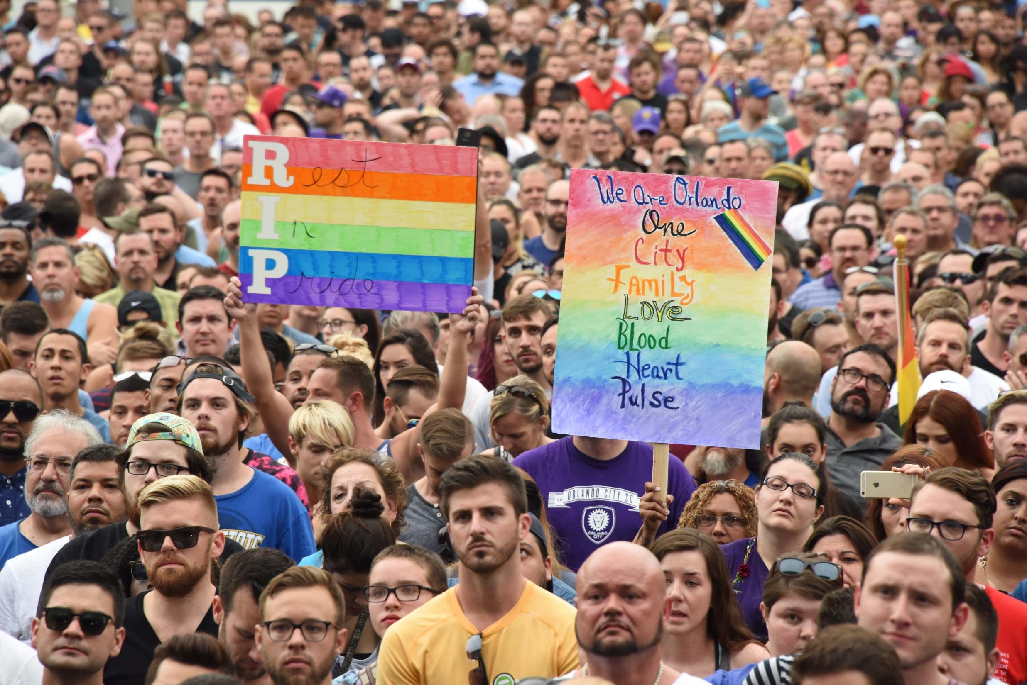
IN THE WAKE OF TRAGEDY:
BEST PRACTICES FROM ORLANDO’S NIGHTCLUB SHOOTING
Heather Fagan, City of Orlando • Kena Lewis, Orlando Health • Michelle Guido, Orlando Police

Slide 2
TIMELINE
JUNE 12, 2016

Slide 3
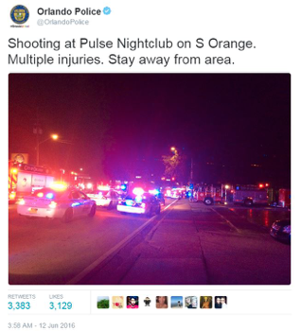
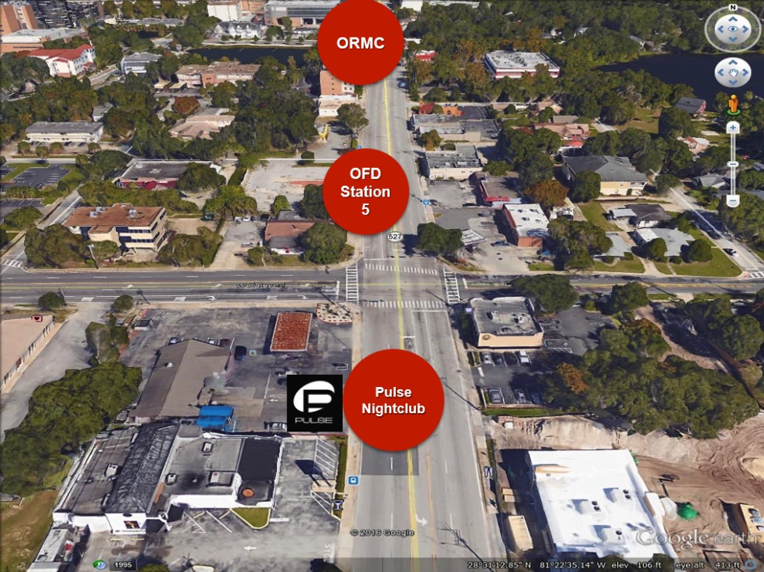
2:02 am
Shooting began
3 am
PIO and Media Relations notified
3:45 am
PIO and Media Relations
On-scene

Slide 4
7:30 am
first press conference
10:30 am
SECOND press conference
2:45 pm
THIRD press conference

Slide 5
SOCIAL
MEDIA
STRATEGIES

Slide 6
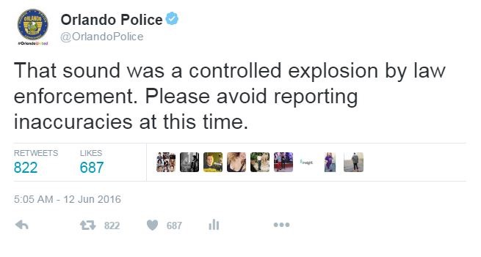
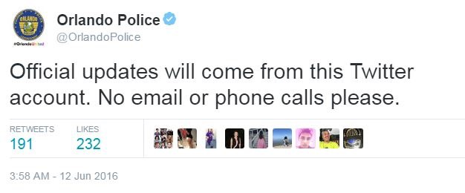
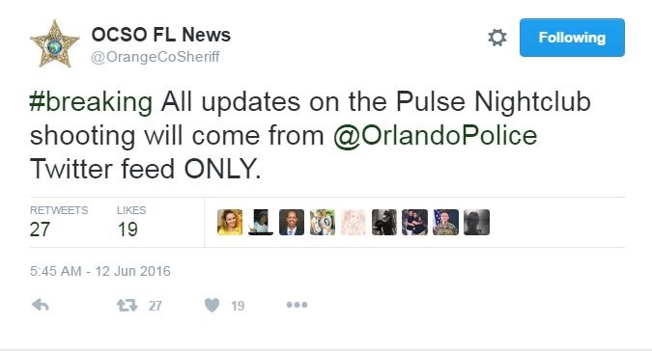
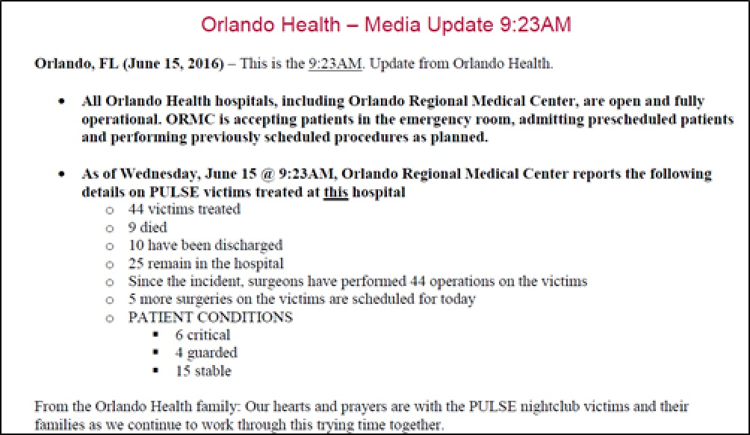
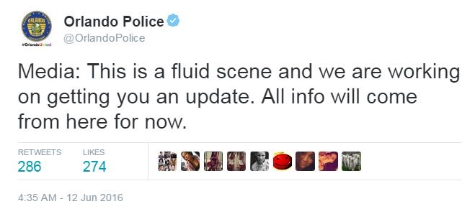
MANAGING
THE MEDIA

Slide 7
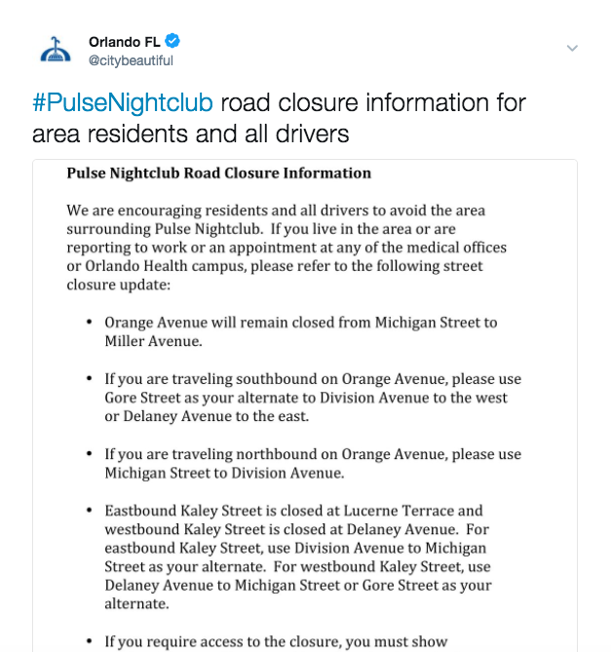
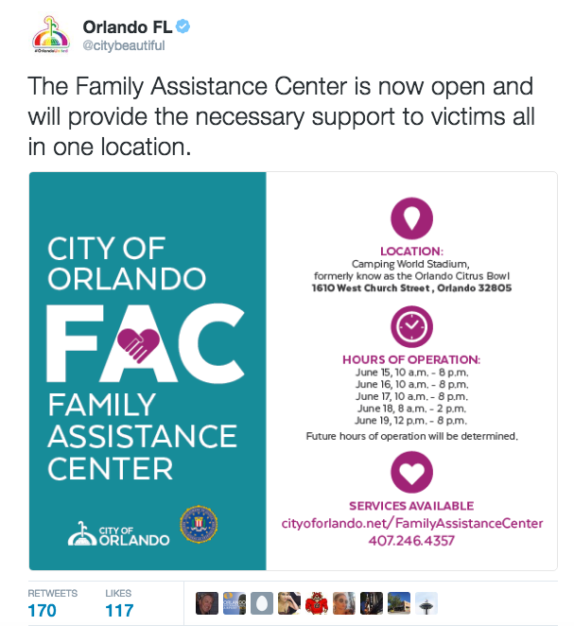
PUBLIC
INFORMATION

Slide 8
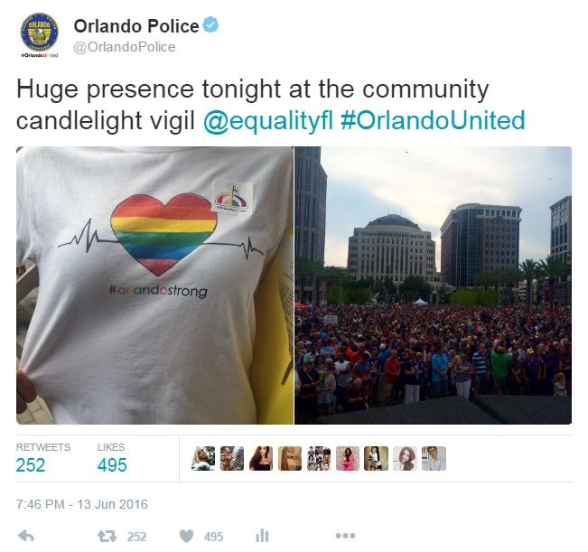
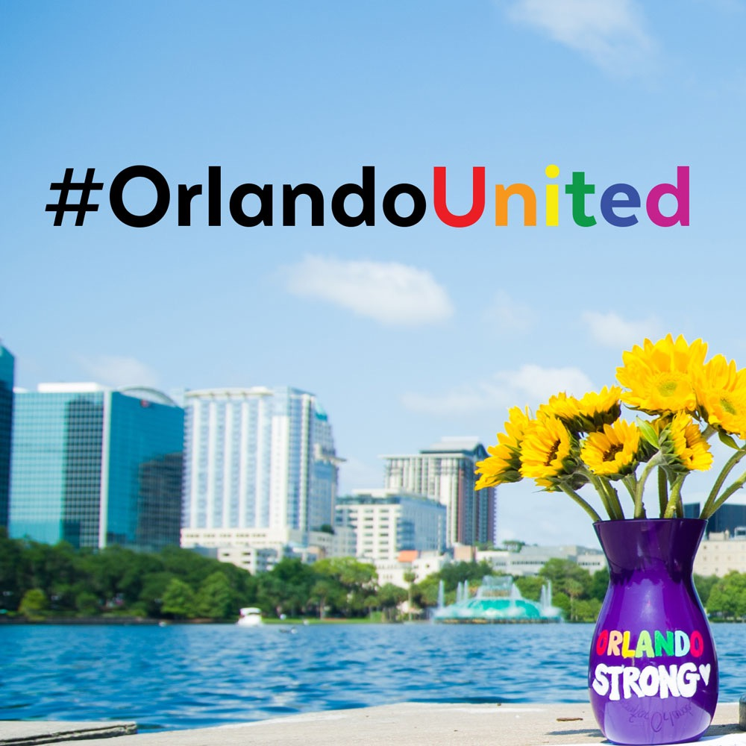
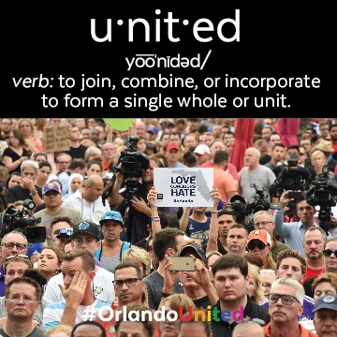
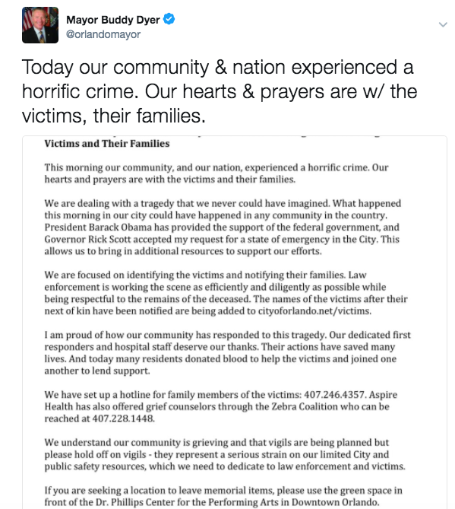
BUILD
CIVIC
RESILIENCE

Slide 9
PRESS
STRATEGIES

Slide 10
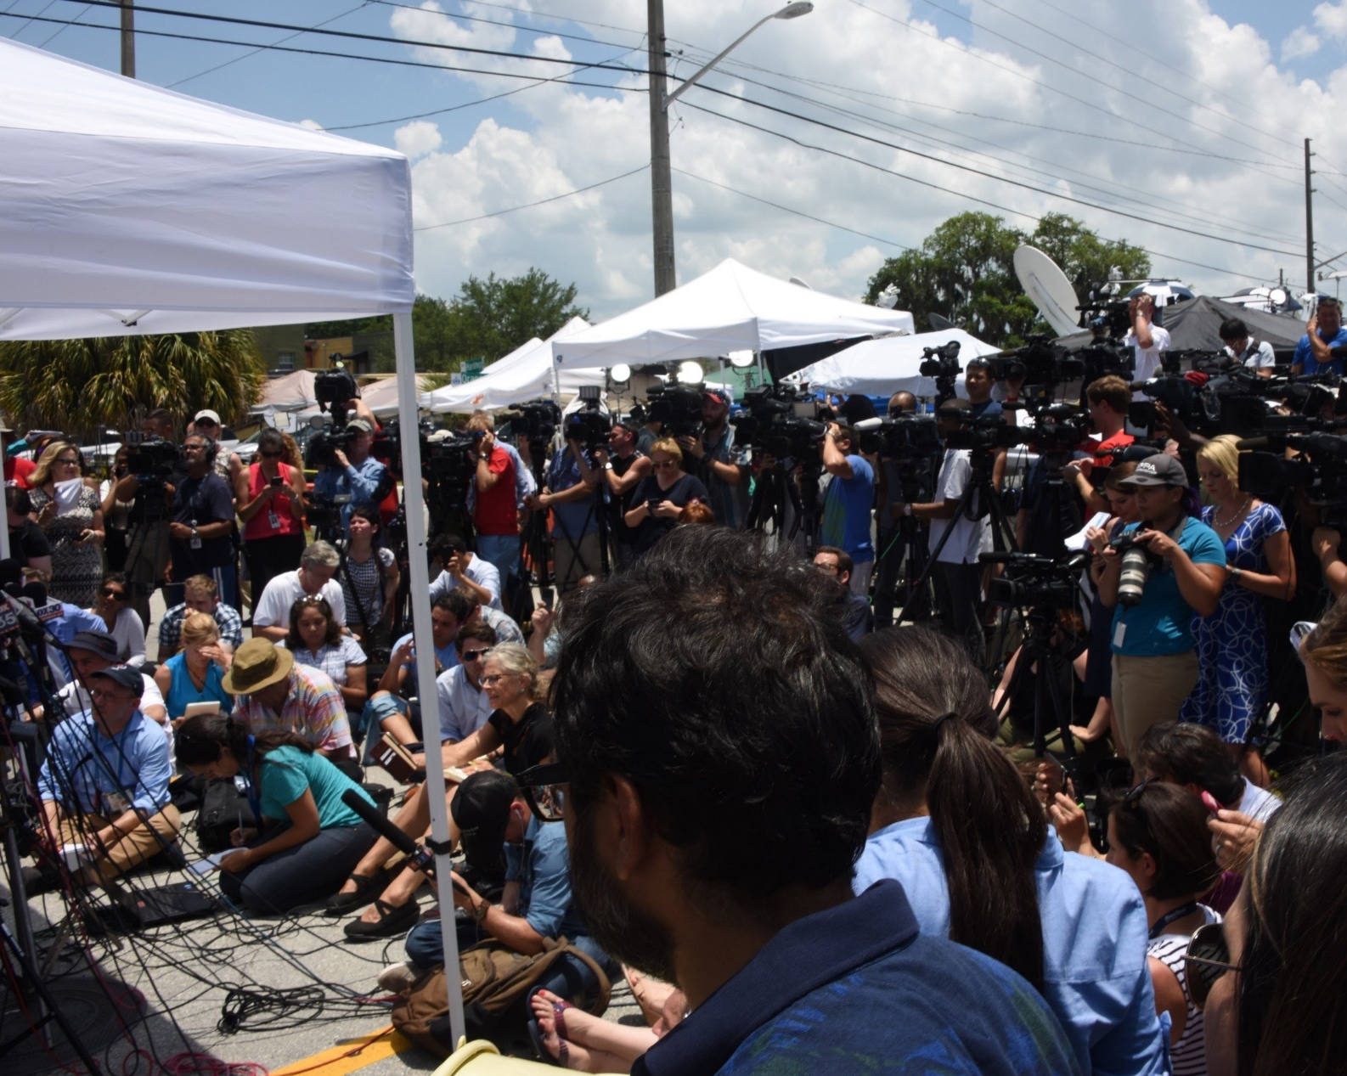
LOCAL, NATIONAL, AND INTERNATIONAL MEDIA

Slide 11
PUT YOUR CAPTION HERE

Slide 12
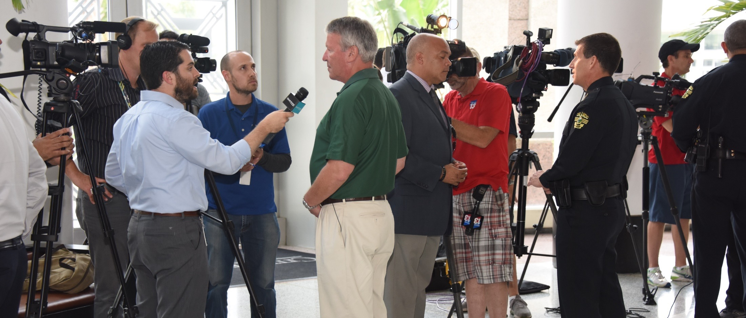
QUICK TIPS
NEWS MONITORING
RECORD INTERVIEWS
CAMERAS ARE ALWAYS ON
CORRECTIONS
EMAIL OUT OF OFFICE

Slide 13
LONG TERM
COMMUNICATIONS

Slide 14
VIGILS
MEMORIALS
PUBLIC RECORDS
ASSISTANCE CENTER

Slide 15
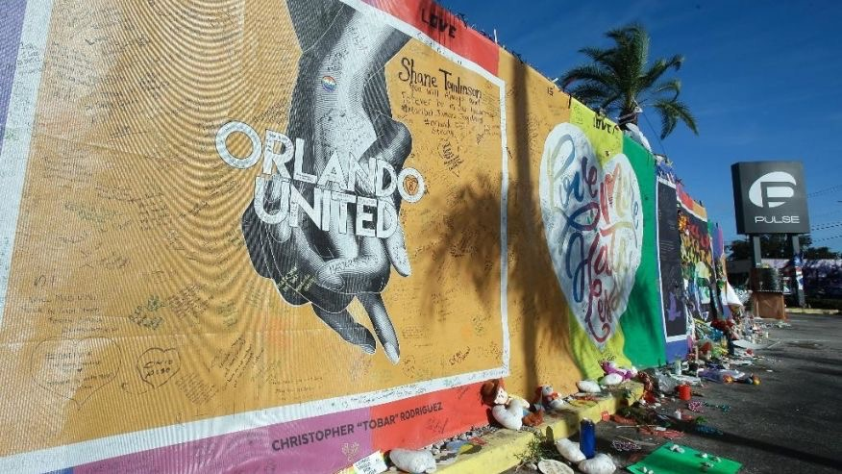
1 MONTH – 6 MONTH – ONE YEAR
OneOrlando FUND

Slide 16
LESSONS
LEARNED

Slide 17
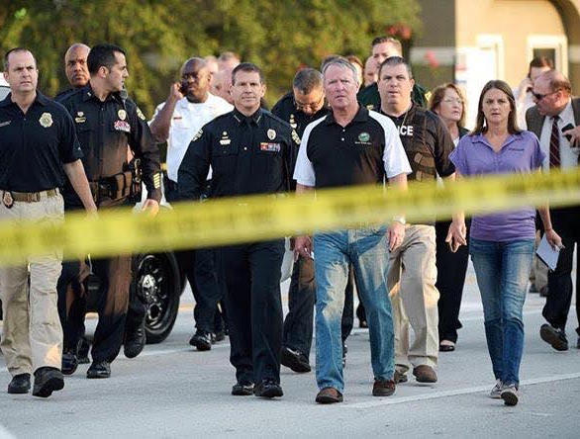
RELATIONSHIPS
SUPPORT FROM OTHER AGENCIES
HAVE A PLAN
MULTICULTURAL RESPONSE
DO I HAVE TO MAKE THIS DECISION TODAY?
WEBSITE/COORDINATION WITH TECH DEPT
DOCUMENT EVERYTHING
JUMP BAG

Slide 19
